Slide 1
Subject Name: DATA WAREHOUSING AND MINING
Unit No:1
Unit Name: INTRODUCTION TO DATA WAREHOUSING
Faculty Name : Mrs.Bhavana Chaudhari

Slide 2
Index
Lecture 1: Introduction to Data Warehouse, Data warehouse architecture
Lecture 2: Data warehouse versus Data Marts, E-R Modelling versus Dimensional Modelling
Lecture 3: Information Package Diagram, Data Warehouse Schemas; Star Schema
2
Notes:
2

Slide 3
Unit :1 Unit Name: Introduction to Data Warehousing
Lecture No: 1
Introduction to Data Warehouse, Data warehouse architecture
Notes:
3

Slide 4
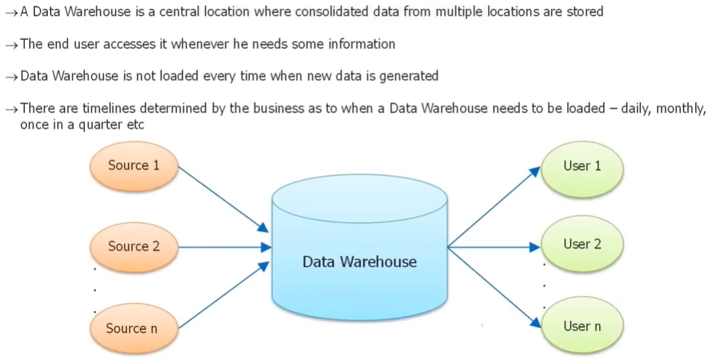
What is Data Warehouse ?
4
4
Lecture no 1:Introduction to Data Warehouse, Data warehouse architecture
Notes:
4

Slide 5
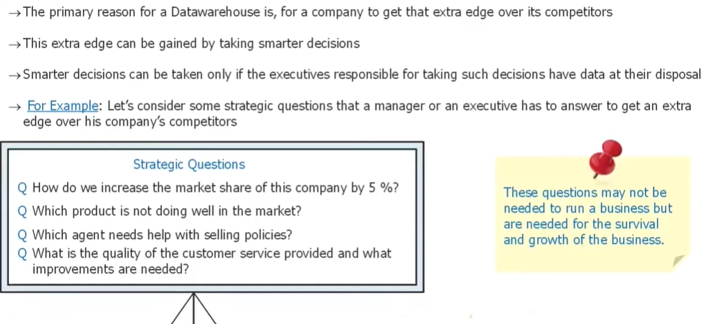
Why do we need Data Warehouse ?
5
5
Lecture no 1:Introduction to Data Warehouse, Data warehouse architecture
Notes:
5

Slide 6
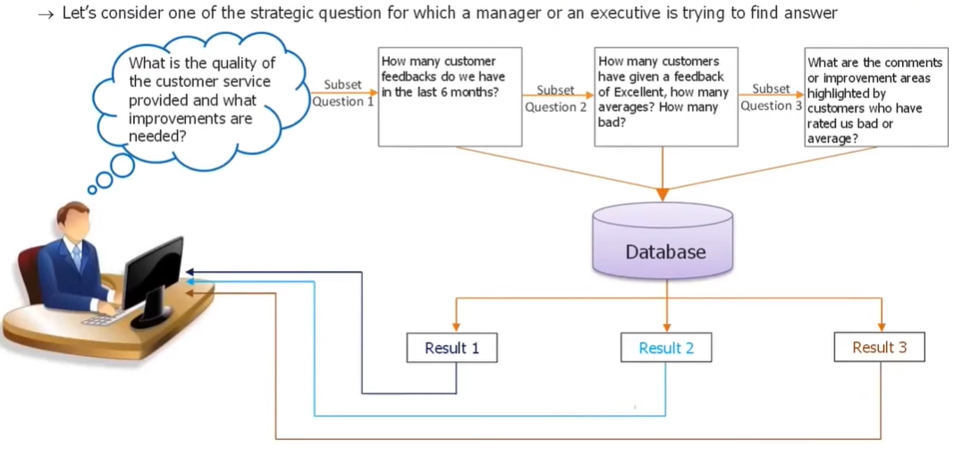
Why is Data Warehouse so important?
6
6
Lecture no 1:Introduction to Data Warehouse, Data warehouse architecture
Notes:
6

Slide 7
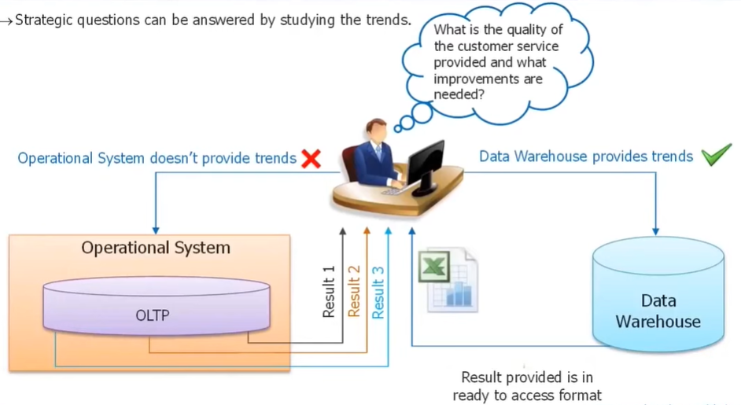
Why is Data Warehouse so important? Cont..
7
7
Lecture no 1:Introduction to Data Warehouse, Data warehouse architecture
Notes:
7

Slide 8
Functional definition of Data Warehouse
The data warehouse is an informational environment that:
Provides an integrated and total view of the enterprise
Makes the enterprise’s current and historical information easily available for decision making
Makes decision-support transactions possible without hindering operational systems
Renders the organization’s information consistent
Presents a flexible and interactive source of strategic information
Bill Inmon, considered to be the father of Data Warehousing provides the following definition:
“A Data Warehouse is a subject oriented, integrated, nonvolatile, and time variant collection of data in support of management’s decisions.”
8
Lecture no 1:Introduction to Data Warehouse, Data warehouse architecture

Slide 9
Features of Data Warehousing
Sean Kelly, data warehouse practitioner, defines the data warehousing in following way. The data in data warehousing is:
Subject oriented
Integrated
Time stamped
Non-volatile
9
Lecture no 1:Introduction to Data Warehouse, Data warehouse architecture

Slide 10
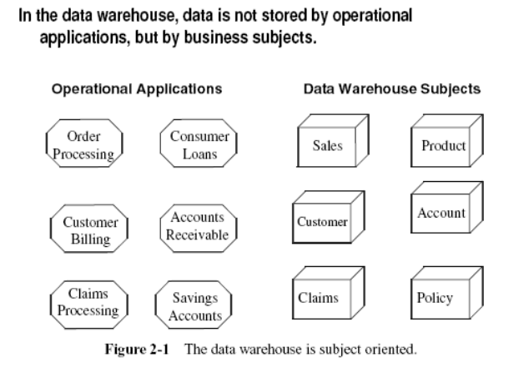
Features of Data Warehousing – subject oriented data
10
Lecture no 1:Introduction to Data Warehouse, Data warehouse architecture

Slide 11
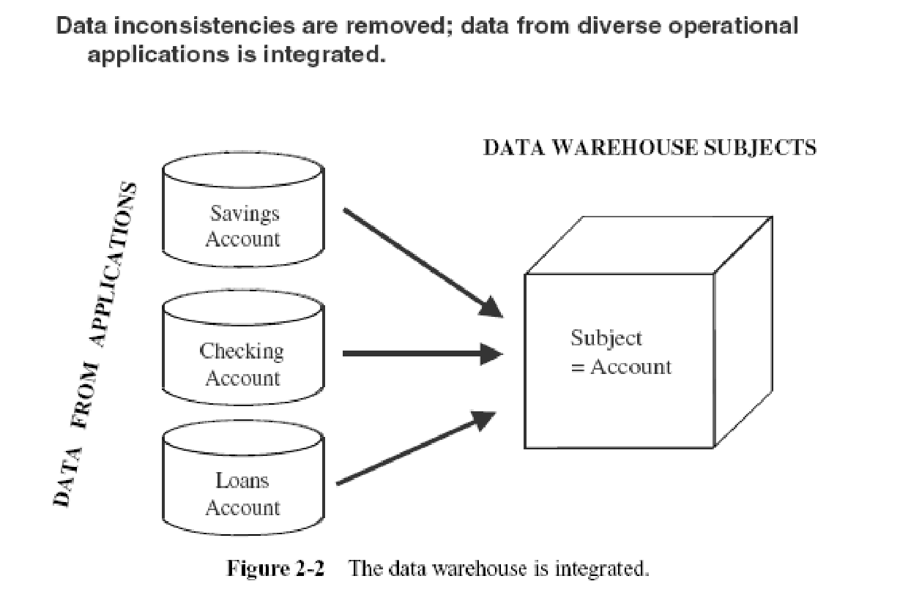
Features of Data Warehousing – integrated data
11
Lecture no 1:Introduction to Data Warehouse, Data warehouse architecture

Slide 12
Features of Data Warehousing – integrated data
Before the data from various disparate sources can be usefully stored in a data warehouse, you have to:
remove the inconsistencies;
standardize the various data elements;
make sure of the meanings of data names in each source application
Before moving the data into the data warehouse, you have to go through a process of transformation, consolidation, and integration of the source data
Here are some of the items that would need standardization:
Naming conventions
Codes
Data attributes
Measurements
12
Lecture no 1:Introduction to Data Warehouse, Data warehouse architecture

Slide 13
Features of Data Warehousing – Time Variant
For an operational system, the stored data contains the current values.
The data in the data warehouse is meant for analysis and decision making.
A data warehouse, because of the vary nature of its purpose, has to contain historical data, not just current values
Data is stored as snapshots over past and current periods
Every data structure in the data warehouse contains the time element
The time variant nature of data in a data warehouse
Allows for analysis of the past
Relates information to the present
Enables forecast for the future
13
Lecture no 1:Introduction to Data Warehouse, Data warehouse architecture

Slide 14
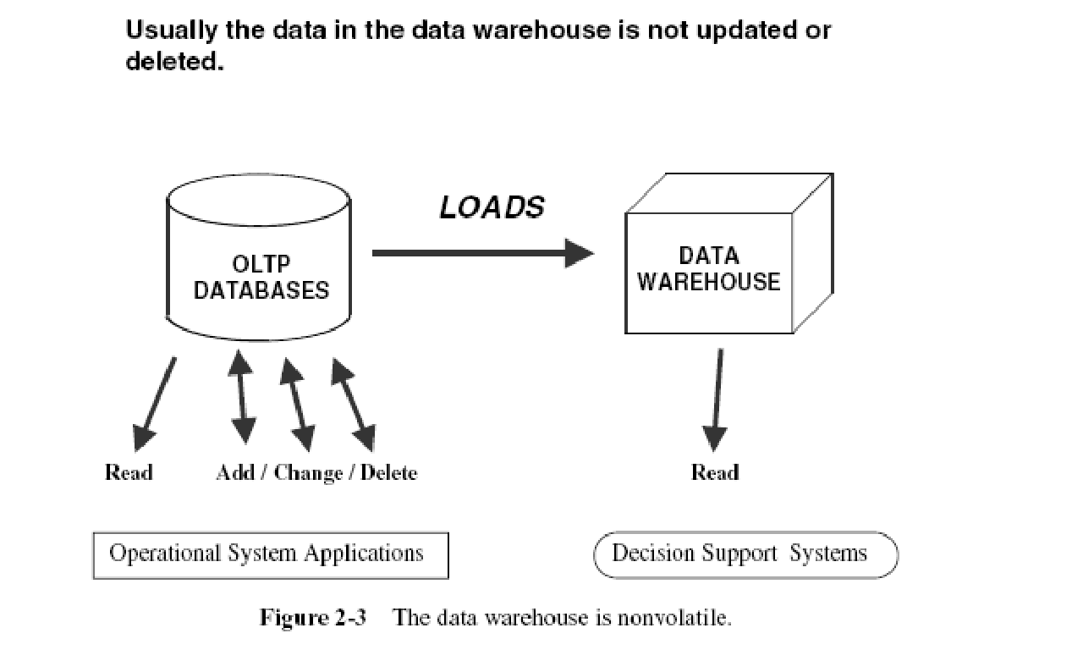
Features of Data Warehousing – non volatile data
14
Lecture no 1:Introduction to Data Warehouse, Data warehouse architecture

Slide 15
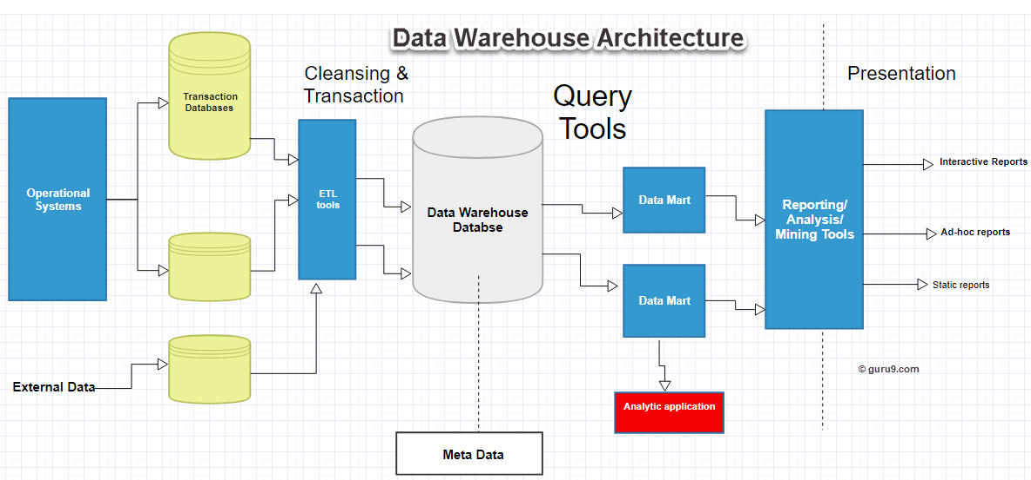
Data Warehouse Architecture
15
15
Lecture no 1:Introduction to Data Warehouse, Data warehouse architecture
Notes:
15

Slide 16
Data Warehouse Architecture
There are 3 approaches for constructing Data Warehouse layers:
Single-tier architecture
The objective of a single layer is to minimize the amount of data stored. This goal is to remove data redundancy. This architecture is not frequently used in practice.
Two-tier architecture
It separates physically available sources and data warehouse.
Not expandable and also not supporting a large number of end-users.
It also has connectivity problems because of network limitations.
Three-Tier Data Warehouse Architecture
This is the most widely used Architecture of Data Warehouse.
16
Lecture no 1:Introduction to Data Warehouse, Data warehouse architecture
Notes:
16

Slide 17
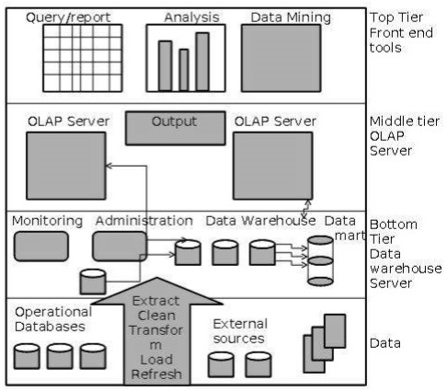
3 Tier Data Warehouse Architecture
17
17
Lecture no 1:Introduction to Data Warehouse, Data warehouse architecture
Notes:
17

Slide 18
3 Tier Data Warehouse Architecture
Generally a data warehouses adopts a three-tier architecture.
Bottom Tier − The bottom tier of the architecture is the data warehouse database server. It is the relational database system. We use the back end tools and utilities to feed data into the bottom tier. These back end tools and utilities perform the Extract, Clean, Load, and refresh functions.
Middle Tier − In the middle tier, we have the OLAP Server that can be implemented in either of the following ways.
By Relational OLAP (ROLAP), which is an extended relational database management system. The ROLAP maps the operations on multidimensional data to standard relational operations.
By Multidimensional OLAP (MOLAP) model, which directly implements the multidimensional data and operations.
Top-Tier − This tier is the front-end client layer. This layer holds the query tools, reporting tools, analysis tools and data mining tools.
18
18
Lecture no 1:Introduction to Data Warehouse, Data warehouse architecture
Notes:
18

Slide 19
Unit :1 Unit Name: Introduction to Data Warehousing
Lecture No: 2
Data warehouse versus Data Marts, E-R Modelling versus Dimensional Modelling
Notes:
19

Slide 20
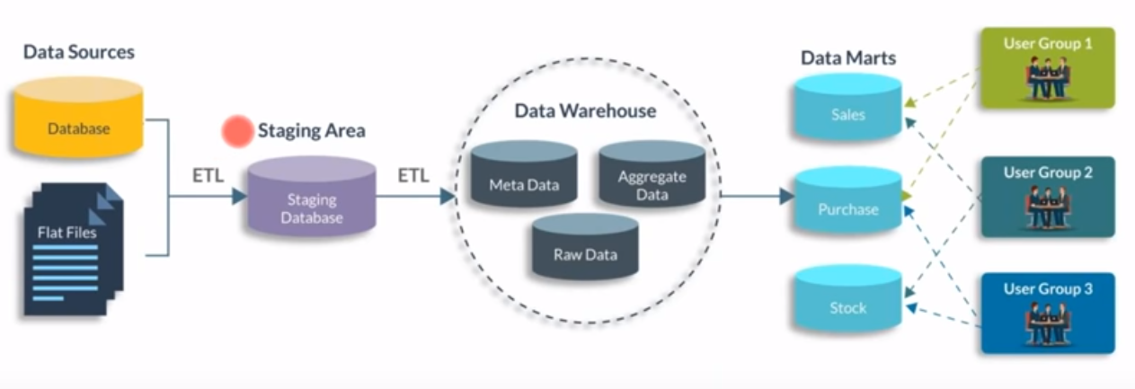
Data Mart
Data mart contains a subset of organization-wide data. This subset of data is valuable to specific groups of an organization.
In other words, we can claim that data marts contain data specific to a particular group. For example, the marketing data mart may contain data related to items, customers, and sales. Data marts are confined to subjects.
20
20
Lecture no 2:Data warehouse versus Data Marts, E-R Modelling versus Dimensional Modelling
Notes:
20

Slide 21
Data Mart
Points to remember about data marts −
Unix/Linux-based servers are used to implement data marts.
They are implemented on low-cost servers.
The implementation data mart cycles is measured in short periods of time, i.e., in weeks rather than months or years.
Data marts are small in size.
Data marts are customized by department.
The source of a data mart is departmentally structured data warehouse.
Data mart are flexible.
21
21
Lecture no 2:Data warehouse versus Data Marts, E-R Modelling versus Dimensional Modelling
Notes:
21

Slide 22
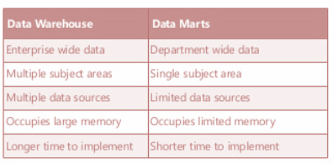
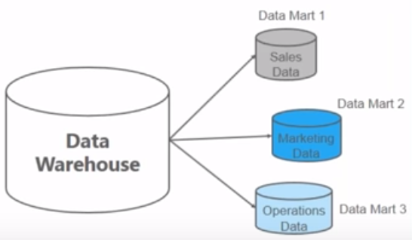
Data warehouse vs Data Mart
Data Mart is smaller version of Data Warehouse which deals with single subject
Data marts are focused on one area, hence they draw data from limited number of sources
Time taken to build data mart is very less compared to DWH
22
22
Lecture no 2:Data warehouse versus Data Marts, E-R Modelling versus Dimensional Modelling
Notes:
22

Slide 23
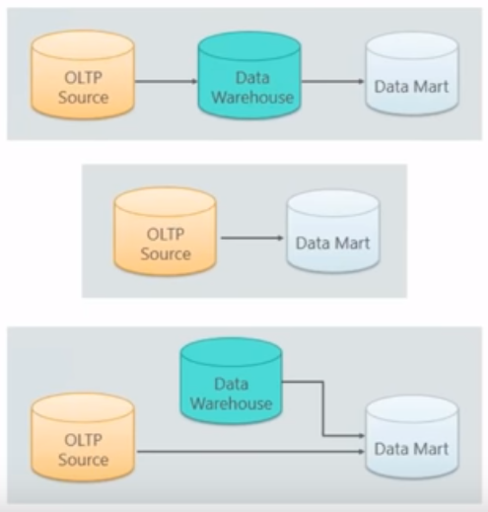
Types of Data Mart
Dependent Data Mart: Data comes from OLTP source to Data Warehouse and then from data warehouse to Data Mart
Independent Data Mart: Data directly received from the source system, This is suitable for small organization
Hybrid Data Mart: Data fed from both OLTP source and DWH
23
23
Lecture no 2:Data warehouse versus Data Marts, E-R Modelling versus Dimensional Modelling
Notes:
23

Slide 24
Data Warehouse Design Approaches:Top-Down and Bottom-Up
Data Warehouse design approaches are very important aspect of building data warehouse.
Selection of right data warehouse design could save lot of time and project cost.
There are two different Data Warehouse Design Approaches normally followed when designing a Data Warehouse solution and based on the requirements of your project you can choose which one suits your particular scenario.
24
24
Lecture no 2:Data warehouse versus Data Marts, E-R Modelling versus Dimensional Modelling
Notes:
24

Slide 25
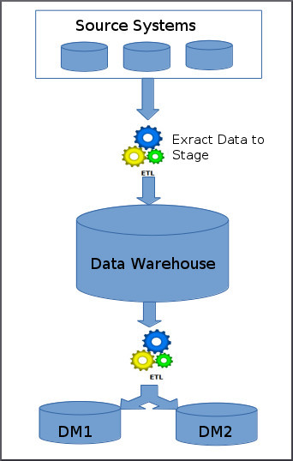
Top-Down Approach for Data warehouse Design
In the top-down approach, the data warehouse is designed first and then data mart are built
Below are the steps that are involved in top-down approach:
Data is extracted from the various source systems using ETL tools, it is validated and pushed to the data warehouse.
You will apply various aggregation, summerization techniques on extracted data from data warehouse and loaded back to the data warehouse
Once the aggregation and summerization is completed, various data marts extract that data and apply the some more transformation to make the data structure as defined by the data marts.
This is bill inmons methodology
25
25
Lecture no 2:Data warehouse versus Data Marts, E-R Modelling versus Dimensional Modelling
Notes:
25

Slide 26
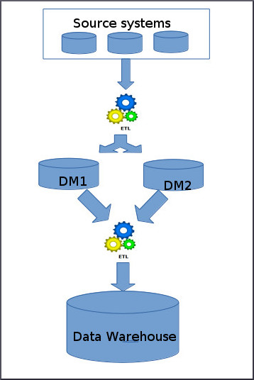
Bottom-up Approach for Data warehouse Design
Ralph Kimball proposed data warehouse design approach is called dimensional modelling or the Kimball methodology.
This methodology follows the bottom-up approach
As per this method, data marts are first created to provide the reporting and analytics capability for specific business process
Later with these data marts, enterprise data warehouse is created
26
26
Lecture no 2:Data warehouse versus Data Marts, E-R Modelling versus Dimensional Modelling
Notes:
26

Slide 27
Dimensional Modelling
What is Dimensional Model?
A dimensional model is a data structure technique optimized for Data warehousing tools.
The concept of Dimensional Modelling was developed by Ralph Kimball and is comprised of "fact" and "dimension" tables.
A Dimensional model is designed to read, summarize, analyze numeric information like values, balances, counts, weights, etc. in a data warehouse.
In contrast, relational models are optimized for addition, updating and deletion of data in a real-time Online Transaction System.
ER modeling is for reducing redundancy of data, where as dimensional model arranges data in such a way that it is easier to retrieve information and generate reports
These dimensional and relational models have their unique way of data storage that has specific advantages.
Dimensional models are used in data warehouse systems and not a good fit for relational systems
27
27
Lecture no 2:Data warehouse versus Data Marts, E-R Modelling versus Dimensional Modelling
Notes:
27

Slide 28
Elements of Dimensional Data Model
Fact
Facts are the measurements/metrics or facts from your business process. For a Sales business process, a measurement would be quarterly sales number
Dimension
Dimension provides the context surrounding a business process event. In simple terms, they give who, what, where of a fact. In the Sales business process, for the fact quarterly sales number, dimensions would be
Who – Customer Names
Where – Location
What – Product Name
In other words, a dimension is a window to view information in the facts.
28
Lecture no 2:Data warehouse versus Data Marts, E-R Modelling versus Dimensional Modelling

Slide 29
Elements of Dimensional Data Model
Attributes
The Attributes are the various characteristics of the dimension in dimensional data modeling.
In the Location dimension, the attributes can be
State
Country
Zipcode etc.
Attributes are used to search, filter, or classify facts. Dimension Tables contain Attributes
29
Lecture no 2:Data warehouse versus Data Marts, E-R Modelling versus Dimensional Modelling

Slide 30
What is Fact Table?
A Fact table stores quantified data to measure the business performance.
It is a measure that can be summed, averaged or manipulated.
Fact table is a table surrounded by the dimension tables in the Star Schema of Data Warehouse.
The Fact table consists of two types of column:
A Dimension key (foreign key) – A foreign key that joins with dimension tables
A Measure – where data is analyzed
A dimension table is a table in a star schema of a data warehouse.
A dimension table stores attributes, or dimensions, that describe the objects in a fact table.
30
Lecture no 2:Data warehouse versus Data Marts, E-R Modelling versus Dimensional Modelling

Slide 31
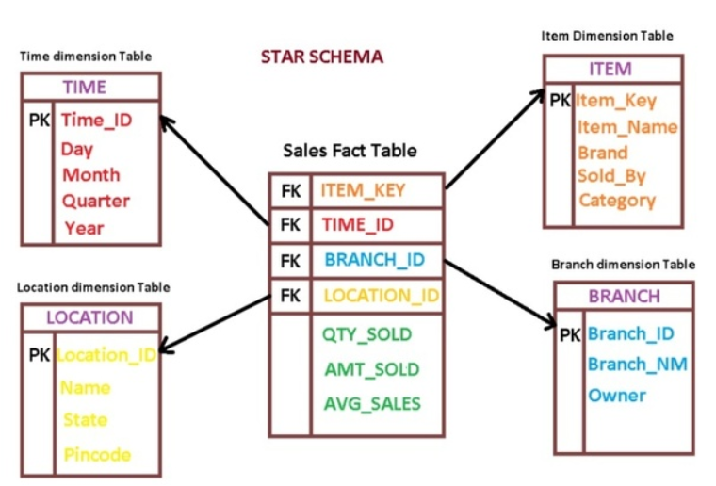
Fact and Dimensional Table
31
Lecture no 2:Data warehouse versus Data Marts, E-R Modelling versus Dimensional Modelling

Slide 32
ER Modelling vs Dimensional Modelling
ER Modeling
Dimensional Modeling
Data Stored in RDBMS
Data Stored in RDBMS or Multidimensional databases
Tables are unit of storage
Cubes are the unit of storage
Data is normalized and used for OLTP
Data is de normalized and used for data warehouse and data marts
Several tables and chain of relationship between them
Few facts tables are connected to several dimension tables
Volatile(frequent updates)
Non volatile
Time variant
Time invariant
Detailed level of transaction data
Summary of bulky transaction data (Aggregations and measures) are used in business decisions
SQL is used to manipulate the data
SQL or MDX are used to manipulate the data
Normal reports
Interactive reports, user friendly, drag and drop MD OLAP reports
32
32
Lecture no 2:Data warehouse versus Data Marts, E-R Modelling versus Dimensional Modelling
Notes:
32

Slide 33
Unit :1 Unit Name: Introduction to Data Warehousing
Lecture No: 3
Information Package Diagram, Data Warehouse Schemas; Star Schema
Notes:
33

Slide 34
DEFINING THE BUSINESS REQUIREMENTS
In several ways, building a data warehouse is very different from building an operational system.
This becomes notable especially in the requirements gathering phase.
Because of this difference, the traditional methods of collecting requirements that work well for operational systems cannot be applied to data warehouses.
34
34
Lecture no 3: Information Package Diagram, Data Warehouse Schemas; Star Schema
Notes:
34

Slide 35
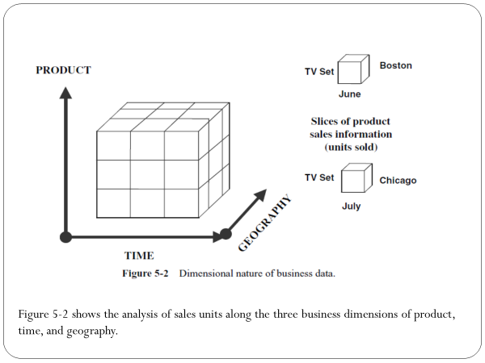
Dimensional Nature of Business Data
In data warehousing system, the users are generally unable to define their requirements clearly.
Users cannot define precisely what information they really want from the data warehouse, nor can they express how they would like to use the information or process it.
Managers think of the business in terms of business dimensions.
If your users of the data warehouse think in terms of business dimensions for decision making, you should also think of business dimensions while collecting requirements.
35
35
Lecture no 3: Information Package Diagram, Data Warehouse Schemas; Star Schema
Notes:
35

Slide 36
Information Package Diagram
Information Packages –
Novel idea for determining and recording information requirements for a data warehouse.
Determining requirements for a data warehouse is based on business dimensions
The relevant dimension and measurements in that dimension are captured and kept in a data warehouse
This creates an information package for a specific subject
36
36
Lecture no 3: Information Package Diagram, Data Warehouse Schemas; Star Schema
Notes:
36

Slide 37
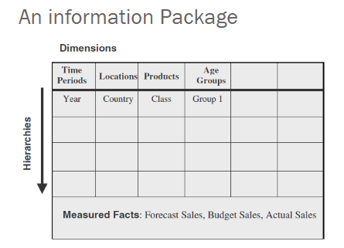
Information Package Diagram
37
37
Lecture no 3: Information Package Diagram, Data Warehouse Schemas; Star Schema
Notes:
37

Slide 38
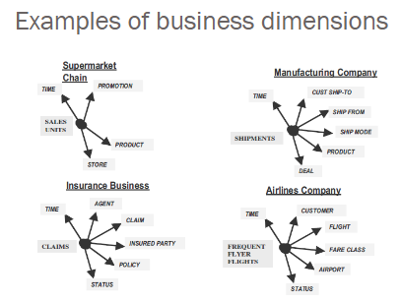
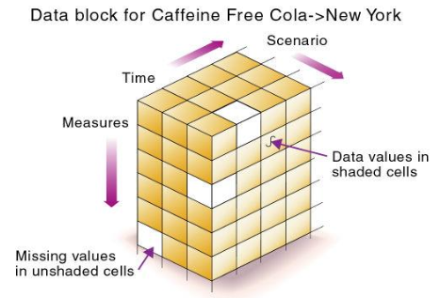
Information Package Diagram
Business dimensions
In requirements collection phase, the end users can provide the measurements which are important to that department.
They can also give insights of combining the various pieces of information for strategic decision making.
Managers think of business in terms of business dimensions
The managers try to evaluate business in different dimensions.
38
38
Lecture no 3: Information Package Diagram, Data Warehouse Schemas; Star Schema
Notes:
38

Slide 39
Example :information package for analyzing sales for a certain business
The subject here is sales.
The measured facts or the measurements that are of interest for analysis are shown in the bottom section of the package diagram. In this case, the measurements are actual sales, forecast sales, and budget sales.
The business dimensions along which these measurements are to be analyzed are shown at the top of diagram as column headings.
In our example, these dimensions are time, location, product, and demographic age group. Each of these business dimensions contains a hierarchy or levels.
For example, the time dimension has the hierarchy going from year down to the level of individual day. The other intermediary levels in the time dimension could be quarter, month, and week.
These levels or hierarchical components are shown in the information package diagram. The subject here is sales.
39
Lecture no 3: Information Package Diagram, Data Warehouse Schemas; Star Schema

Slide 40
IPD enables you to….
Define the common subject areas
Design key business metrics
Decide how data must be presented
Determine how users will aggregate or roll up
Decide the data quantity for user analysis or query
Decide how data will be accessed
Establish data granularity
Estimate data warehouse size
Determine the frequency for data refreshing
Ascertain how information must be packaged
40
Lecture no 3: Information Package Diagram, Data Warehouse Schemas; Star Schema

Slide 41
Dimension Hierarchies/Categories
When a user analyzes the measurements along a business dimension, the user usually would like to see the numbers first in summary and then at various levels of detail.
What the user does here is to traverse the hierarchical levels of a business dimension for getting the details at various levels.
The hierarchy of the time dimension consists of the levels of year, quarter, and month.
The dimension hierarchies are the paths for drilling down or rolling up in our analysis.
Within each major business dimension there are categories of data elements that can also be useful for analysis.
Hierarchies and categories are included in the information packages for each dimension.
41
Lecture no 3: Information Package Diagram, Data Warehouse Schemas; Star Schema

Slide 42
Dimensional Data Modeling
Dimensional Data Modeling is one of the data modeling techniques used in data warehouse design.
Goal: Improve the data retrieval
The concept of Dimensional Modeling was developed by Ralph Kimball which is comprised of facts and dimension tables
Since the main goal of this modeling is to improve the data retrieval so it is optimized for SELECT OPERATION
The advantage of using this model is that we can store data in such a way that it is easier to store and retrieve the data once stored in a data warehouse.
Dimensional model is the data model used by many OLAP systems.
42
42
Lecture no 3: Information Package Diagram, Data Warehouse Schemas; Star Schema
Notes:
42

Slide 43
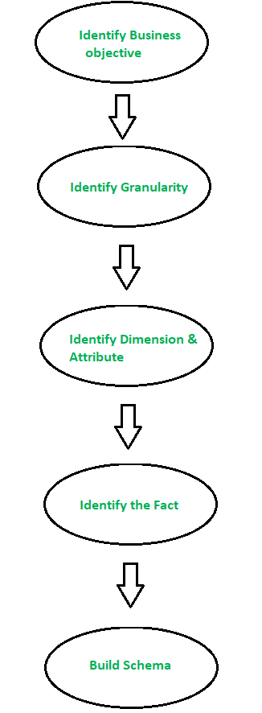
Dimensional Data Modeling
Steps to Create Dimensional Data Modeling:
Step-1: Identifying the business objective –
The first step is to identify the business objective. Sales, HR, Marketing, etc. are some examples as per the need of the organization.
Since it is the most important step of Data Modelling the selection of business objective also depends on the quality of data available for that process.
Step-2: Identifying Granularity –
Granularity is the lowest level of information stored in the table.
The level of detail for business problem and its solution is described by Grain.
43
43
Lecture no 3: Information Package Diagram, Data Warehouse Schemas; Star Schema
Notes:
43

Slide 44
Dimensional Data Modeling
Step-3: Identifying Dimensions and its Attributes –
Dimensions are objects or things like table. Dimensions categorize and describe data warehouse facts and measures in a way that support meaningful answers to business questions.
A data warehouse organizes descriptive attributes as columns in dimension tables. For Example, the data dimension may contain data like a year, month and weekday.
Step-4: Identifying the Fact –
The measurable data is hold by the fact table. Most of the fact table rows are numerical values like price or cost per unit, etc.
Step-5: Building of Schema –
We implement the Dimension Model in this step. A schema is a database structure.
Popular schemes: Star Schema, Snowflake Schema, Fact constellation scheme
44
44
Lecture no 3: Information Package Diagram, Data Warehouse Schemas; Star Schema
Notes:
44

Slide 45
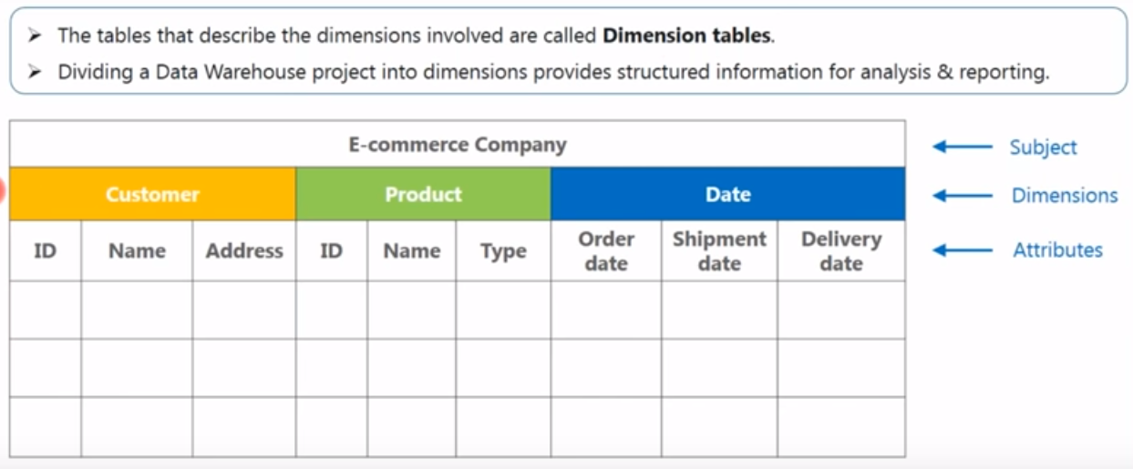
Dimensions
End Users fires a queries on these tables which contains descriptive information
45
45
Lecture no 3: Information Package Diagram, Data Warehouse Schemas; Star Schema
Notes:
45

Slide 46
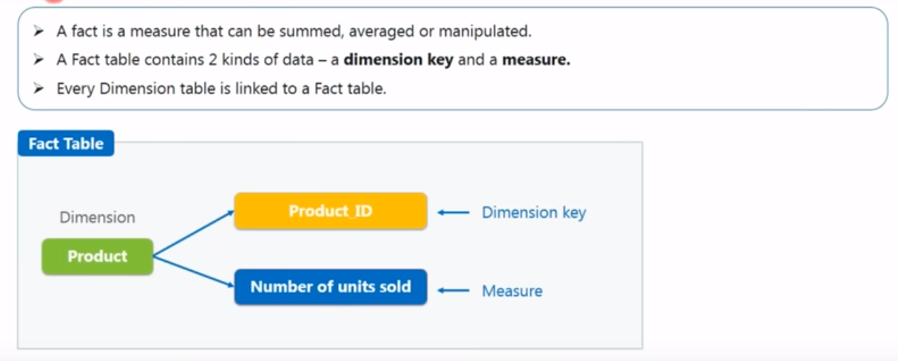
Facts and Measures
46
46
Lecture no 3: Information Package Diagram, Data Warehouse Schemas; Star Schema
Notes:
46

Slide 47
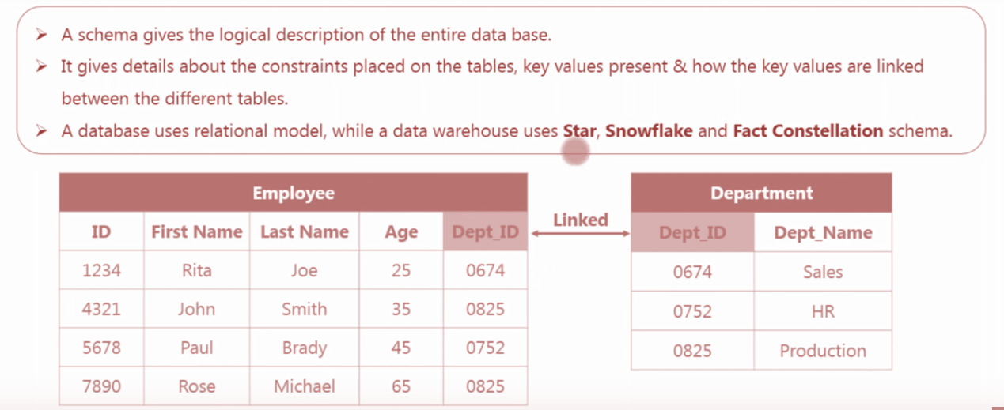
Schema
47
47
Lecture no 3: Information Package Diagram, Data Warehouse Schemas; Star Schema
Notes:
47

Slide 48
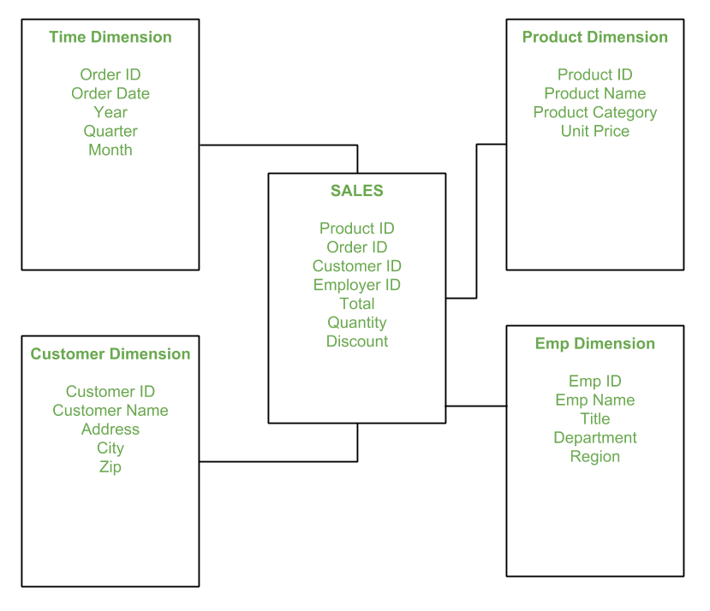
Star Schema in Data Warehouse modeling
Star schema is the fundamental schema among the data mart schema and it is simplest.
This schema is widely used to develop or build a data warehouse and dimensional data marts.
It includes one or more fact tables indexing any number of dimensional tables.
The star schema is a necessary case of the snowflake schema. It is also efficient for handling basic queries.
It is said to be star as its physical model resembles to the star shape having a fact table at its center and the dimension tables at its peripheral representing the star’s points.
48
48
Lecture no 3: Information Package Diagram, Data Warehouse Schemas; Star Schema
Notes:
48

Slide 49
Star Schema in Data Warehouse modeling
In the above demonstration,
SALES is a fact table having attributes i.e. (Product ID, Order ID, Customer ID, Employer ID, Total, Quantity, Discount) which references to the dimension tables(first 4) and next 3 are measures.
Employee dimension table contains the attributes: Emp ID, Emp Name, Title, Department and Region.
Product dimension table contains the attributes: Product ID, Product Name, Product Category, Unit Price.
Customer dimension table contains the attributes: Customer ID, Customer Name, Address, City, Zip.
Time dimension table contains the attributes: Order ID, Order Date, Year, Quarter, Month.
49
49
Lecture no 3: Information Package Diagram, Data Warehouse Schemas; Star Schema
Notes:
49

Slide 50
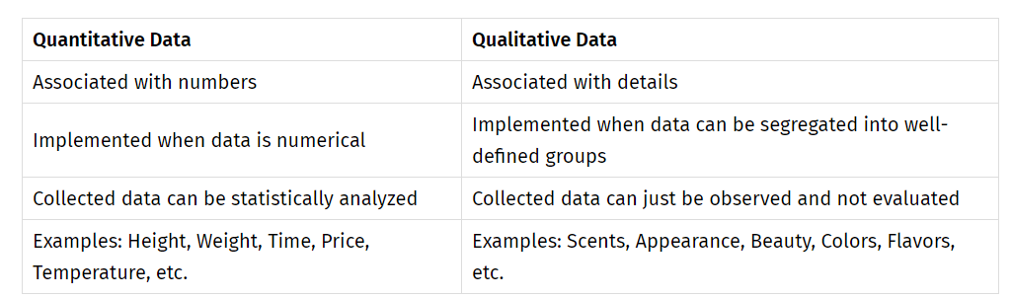
Star Schema in Data Warehouse modeling
Model of Star Schema –
In Star Schema, Business process data, that holds the
quantitative data about a business is distributed in fact tables, and
dimensions which are descriptive characteristics related to fact data.
Sales price, sale quantity, distance, speed, weight, and weight measurements are few examples of fact data in star schema.
50
50
Lecture no 3: Information Package Diagram, Data Warehouse Schemas; Star Schema
Notes:
50

Slide 51
Star Schema in Data Warehouse modeling
Advantages of Star Schema –
Simpler Queries:
Join logic of star schema is quite cinch in compare to other join logic which are needed to fetch data from a transactional schema that is highly normalized.
Simplified Business Reporting Logic:
In compared to a transactional schema that is highly normalized, the star schema makes simpler common business reporting logic, such as as-of reporting and period-over-period.
Feeding Cubes:
Star schema is widely used by all OLAP systems to design OLAP cubes efficiently. In fact, major OLAP systems deliver a ROLAP mode of operation which can use a star schema as a source without designing a cube structure.
51
51
Lecture no 3: Information Package Diagram, Data Warehouse Schemas; Star Schema
Notes:
51

Slide 52
Star Schema in Data Warehouse modeling
Disadvantages of Star Schema –
Data integrity is not enforced well since in a highly de-normalized schema state.
Not flexible in terms if analytical needs as a normalized data model.
Star schemas don’t reinforce many-to-many relationships within business entities – at least not frequently.
52
52
Lecture no 3: Information Package Diagram, Data Warehouse Schemas; Star Schema
Notes:
52

Slide 53
Thank You

